Slide 1
Given a cycle space of a graph generate all
circuits other than fundamental circuits
Group members
Yogesh Gupta (IRM2014004)
Akshat Aggarwal (IIM2014005)
Vishesh Middha (ISM2014007)

Slide 2
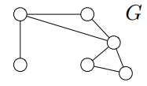
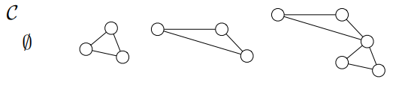
Cycle Space
Cycle space of a graph, G, denoted by C is a set consisting of the φ, all cycles in G (where each cycle is treated as a set of edges) and all unions of edge disjoint cycles in G.

Slide 3
Steps followed
Choose a spanning tree of the graph.
Get the list of fundamental circuits.
Get the list of circuits other than fundamental circuits.

Slide 4
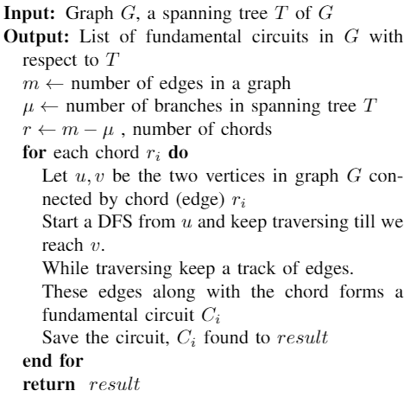
Getting the list of fundamental circuits

Slide 5
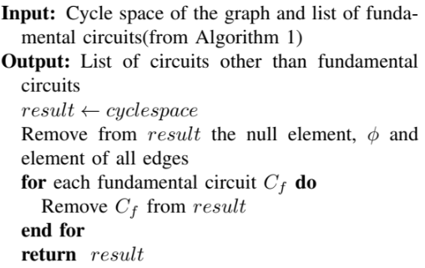
Getting non-fundamental circuits

